Slide 1
Discrete Mathematics
South China University of Technology
1

Slide 2
Chapter 10. Trees
Introduction to Trees
Section 10.1
2

Slide 3
Contents
1
Introduction to Trees
2
Trees as Models
3
Properties of Trees
3

Slide 4
Introduction to Trees
4

Slide 5
Trees
A connected graph that contains no simple circuits is called a tree.
Tree were used as long ago as 1857 by English mathematician Arthur Cayley used them to count certain types of chemical compounds.化合物
Trees are particularly useful in computer science, where they are employed in a wide range of algorithms.

Slide 6
An Example of Trees
Nikolaus
1623-1708
Jacob I
Nikolaus
Johann I
1654-1705
1662-1716
1667-1748
Nikolaus I
Nikolaus II
Daniel
Johann II
1687-1759
1695-1726
1700-1782
1710-1790
Johann III
Jacob II
1746-1807
1759-1789

Slide 7
Definition 1
A tree is a connected undirected graph with no simple circuits.
Example 1 Which of the graph are trees?
a
b
a
b
d
d
c
c
e
f
e
f
G1
G2

Slide 8
a
b
a
b
d
c
d
c
e
f
e
f
G3
G4
Circuits
Unconnected

Slide 9
Forrest
Any graph (not necessary connected) that contains no simple circuits is called a forest.
a
b
c
d
e
f
G4

Slide 10
Tree and Forest Examples
A Tree:
A Forest:
Leaves in green, internal nodes in brown.

Slide 11
Forrest

Slide 12
Theorem 1: An undirected graph is a tree if and only if there is a unique simple path between any two of its vertices.
Proof :
(1) T is a tree ⇒ there is a unique simple path.
T is connected with no simple circuits.
Let x and y be two vertices of T.
Since T is connected, there is a simple path between x and y.

Slide 13
Proof of Theorem
Moreover, this path must be unique, for if there were a second such path,
the path formed by combining the first path from x to y followed by the path from y to x obtained by reversing the order of the second path from x to y would form a circuit.
This implies, that there is a simple circuit in T. Hence, there is a unique simple path between any two vertices of a tree.

Slide 14
Proof of Theorem
(2) there is a unique simple path ⇒ T is a tree. there is a unique simple path between any two vertices of a graph T. Then T is connected.
Furthermore, T can have no simple circuits.
To see that this is true, suppose T had a simple circuit that contained the vertices x and y.
Then there would be two simple paths between x and y, since the simple circuit is made up of a simple path from x to y and a second simple path from y to x. The proof is finished.

Slide 15
Rooted Tree
Definition 1: A rooted tree is a tree in which one vertex has been designed as the root and every edge is directed away from the root.
Rooted trees can also be defined recursively. We can change an unrooted tree into rooted tree by choosing any vertex as the root. Note that different choices of the root produce different rooted trees.

Slide 16
Rooted Tree Examples
Note that a given unrooted tree with n nodes yields n different rooted trees.
Same tree except for choice of root
root
root

Slide 17
Rooted-Tree Terminology Exercise
Find the parent, children, siblings, ancestors, & descendants of node f.
o
n
h
r
d
m
b
root
a
c
g
e
i
q
f
p
j
k
l

Slide 18
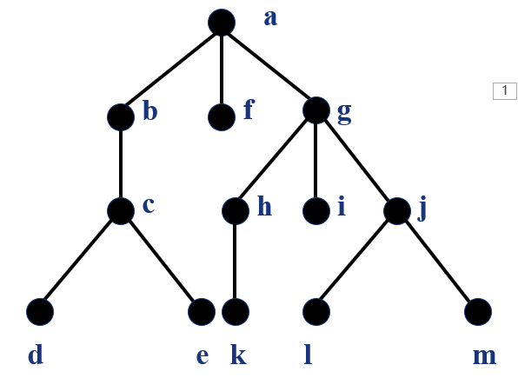
Example 2
find the parent of c, the children of g, the sibling of h, all ancestors of e, all descendants of b, all internal vertices, and all leaves.

Slide 19
What is the subtree rooted at g?
g
h
i
j
k
l
m

Slide 20
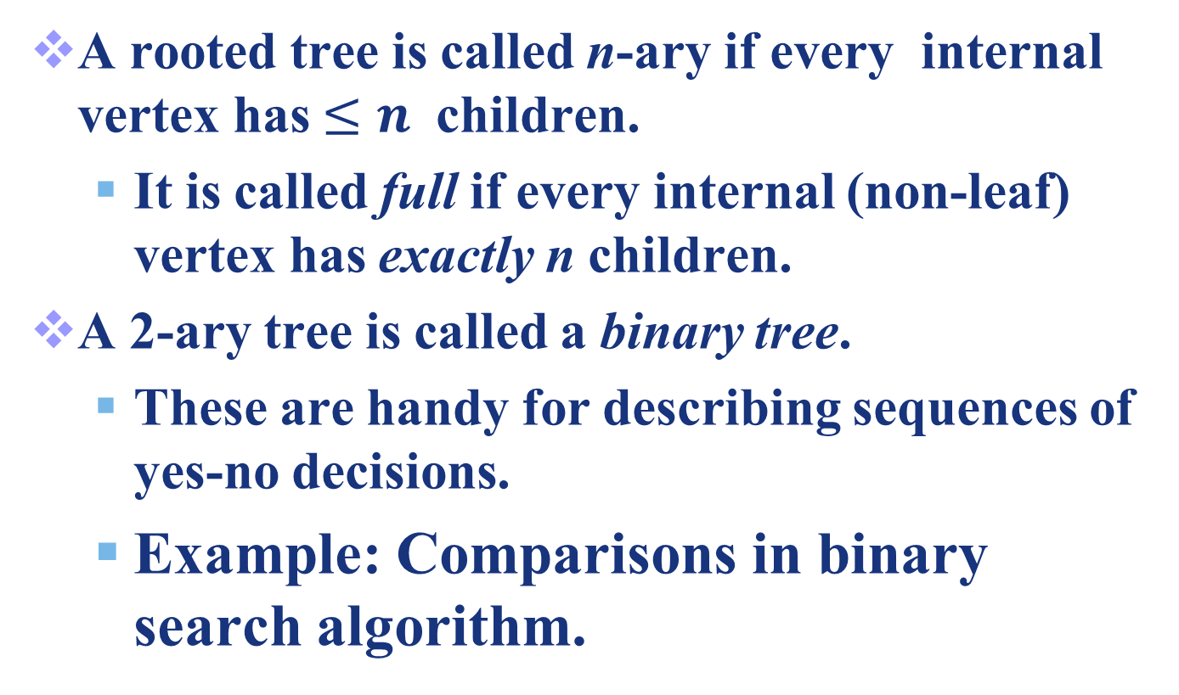
n-ary trees
A rooted tree is called n-ary if every internal vertex has $≤n$ children.
It is called full if every internal (non-leaf) vertex has exactly n children.
A 2-ary tree is called a binary tree.
These are handy for describing sequences of yes-no decisions.
Example: Comparisons in binary search algorithm.

Slide 21
Example 3
Are the rooted trees full m-ary trees for some positive integer m ?
T1 is a full binary tree since each of its internal vertices has two children.

Slide 22
Example 3
T2 is a full 3-ary tree since each of its internal vertices has three children.

Slide 23
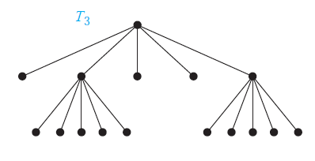
Example 3
In T3 each internal vertex has five children, so T3 is a full 5-ary tree.

Slide 24
T4 is not a full m-ary tree for any m since some of its internal vertices have two children and others have three children.

Slide 25
Ordered Rooted Tree
This is just a rooted tree in which the children of each internal node are ordered.
In ordered binary trees, we can define:
left child, right child
left subtree, right subtree
For n-ary trees with n>2, can use terms like “leftmost”, “rightmost,” etc.

Slide 26
a
h
i
b
c
l
d
e
h
i
j
k
l
m
f
g
j
k
m
The left child of d is f and the right child is g. We show the left and right subtree of c.

Slide 27
Graph Models
27

Slide 28
Trees as Models
Can use trees to model the following:
Saturated hydrocarbons 饱和碳氢化合物
Organizational structures
Computer file systems
In each case, would you use a rooted or a non-rooted tree?

Slide 29
Example 5: Saturated hydrocarbons
Graphs can be used to represent molecules, where atoms are represented by vertices and bonds between them by edges.

Slide 30

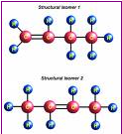

Example 5: Saturated hydrocarbons

Slide 31
Example 6: Representing Organization
The structure of a large organization can be modeled using a rooted tree. Each vertex in this tree represents a position in the organization.
An edge from one vertex to another indicates that the person represented by the initial vertex is the direct boss of the person represented by the terminal vertex.

Slide 32
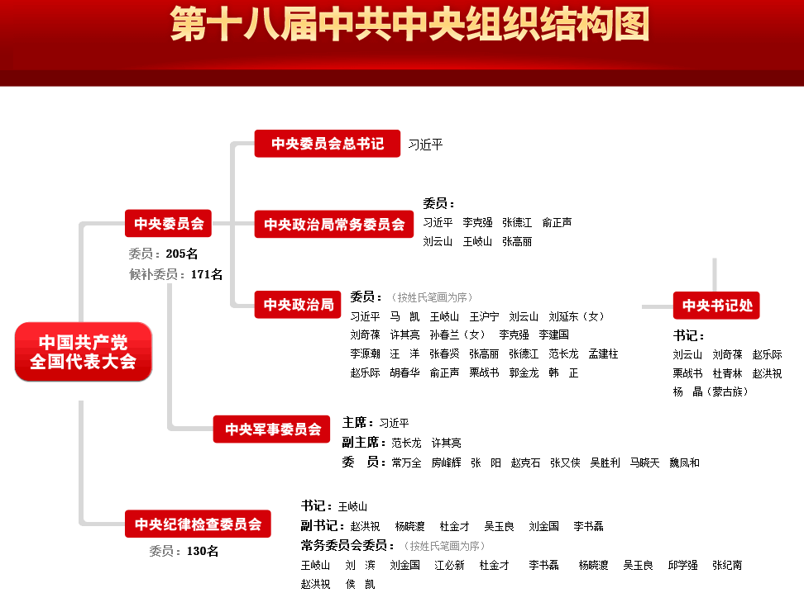

Slide 33
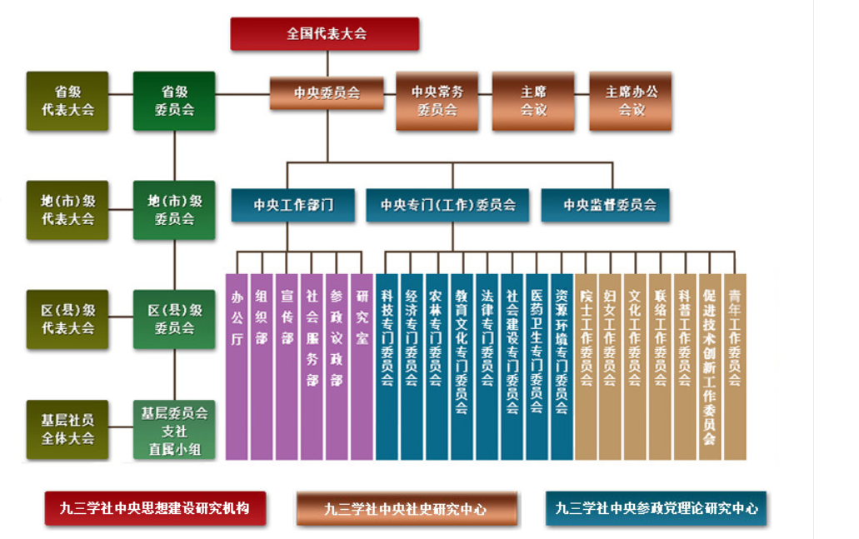
九三学社组织结构

Slide 34
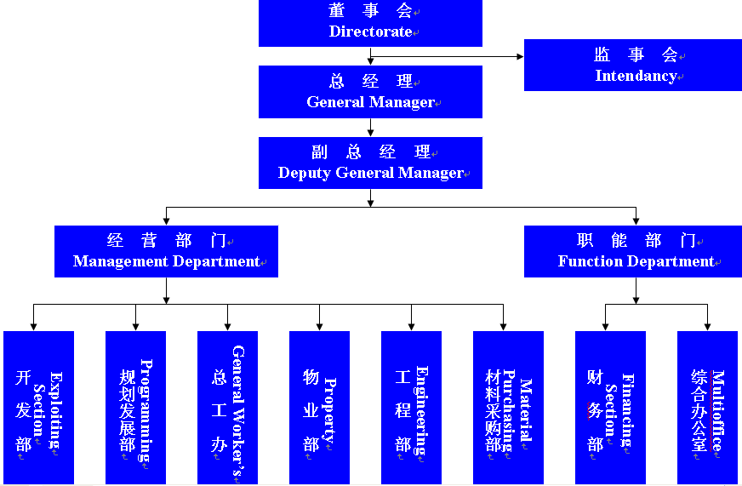

Slide 35
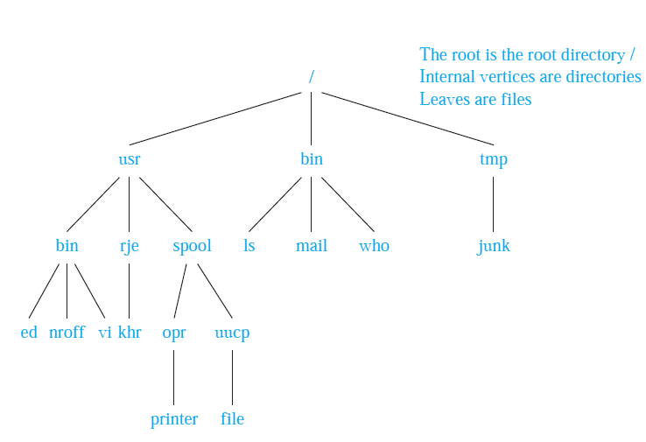
Example 7: Computer File System

Slide 36
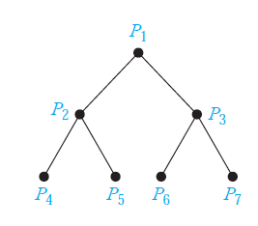
Example 8: Tree-Connected Parallel Processors
we add x1 and x2 using P4, x3 and x4 using P5, x5 and x6 using P6 and x7 and x8 using P7.

Slide 37
Properties of Trees
37

Slide 38
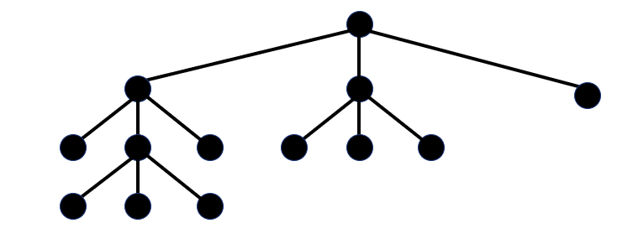
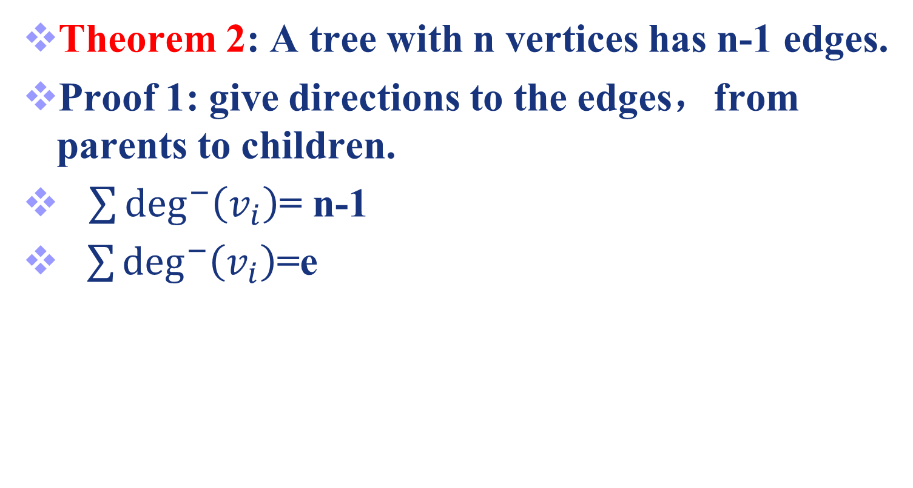
Theorem 2: A tree with n vertices has n-1 edges.
Proof 1: give directions to the edges，from parents to children.
$\sum{\deg^{−}\left(v_{i}\right)}$= n-1
$\sum{\deg^{−}\left(v_{i}\right)}$=e

Slide 39
Proof 2: We will use mathematical induction. Note that for all the trees here we can choose a root and consider the tree rooted.
Basis. Case of n=1. a tree with n=1 vertex has no edges. Thus, the theorem holds.

Slide 40
Induction. Assume that it is true when n=k, i.e. , every tree with k vertices has k-1 edges. we have to show it is true when n=k+1.

Slide 41
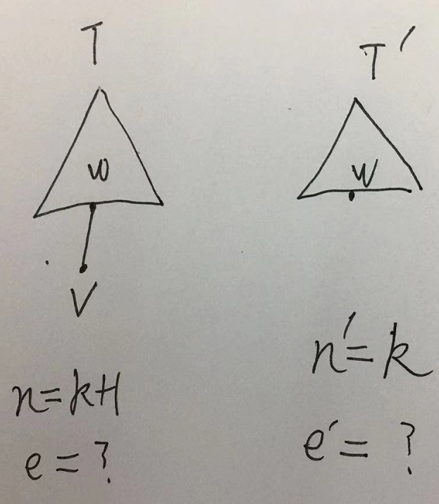
Consider the case of n=k+1, i.e., a tree T has k+1 vertices. Let v be a leaf of T, and let w be the parent of v.
Removing v and (v,w) from T, produces a new tree T’ with k vertices.

Slide 42
T’ is the case of n=k. Thus, T’ has k-1 edges.
It follows that T has k edges since it has one more edge than T’, the edge connecting v and w.

Slide 43
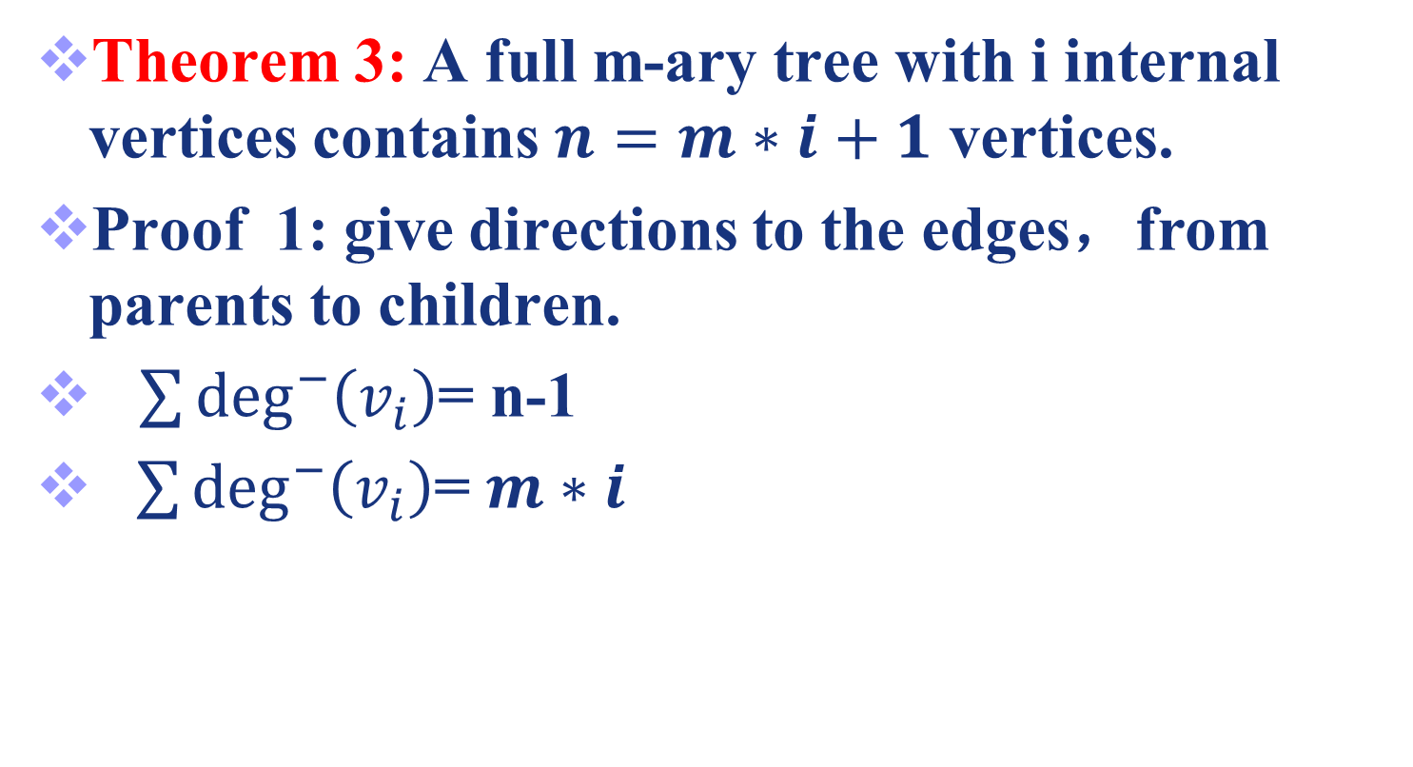
Theorem 3: A full m-ary tree with i internal vertices contains $n=m∗i+1$ vertices.
Proof 1: give directions to the edges，from parents to children.
$\sum{\deg^{−}\left(v_{i}\right)}$= n-1
$\sum{\deg^{−}\left(v_{i}\right)}$= $m∗i$

Slide 44
Proof 2: Every vertex, except the root, is the child of an internal vertices has m children, there are m*i vertices in the tree other than the root.
Therefore, the tree contains n=m*i+1 vertices.

Slide 45
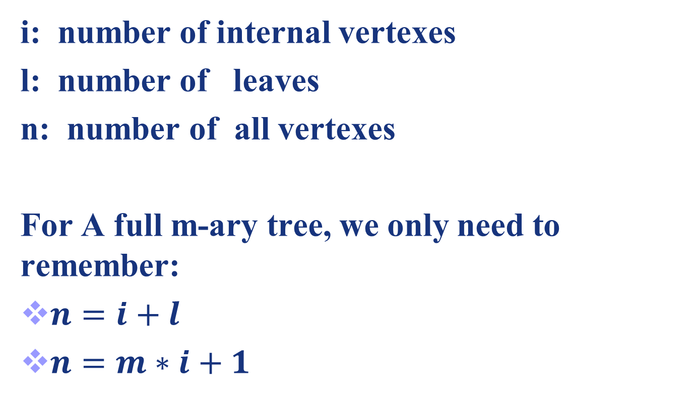
i: number of internal vertexes
l: number of leaves
n: number of all vertexes
For A full m-ary tree, we only need to remember:
$n=i+l$
$n=m∗i+1$

Slide 46
Theorem 4: A full m-ary tree with
(i) n vertices has i=(n-1)/m internal vertices and l=[(m-1)*n+1]/m leaves,
(ii) i internal vertices has n=m*i+1 vertices and l=(m-1)*i+1 leaves,
(iii) l leaves has n=(m*l-1)/(m-1) vertices and i=(l-1)/(m-1) internal vertices.

Slide 47
i: number of internal vertexes
l: number of leaves
n: number of all vertexes
Proof:
Please compare this proof to textbook.

Slide 48
Example 9
Suppose that someone starts chain letter.
Each person who receives the letter is asked to send it on to 4 other people. Some people do this, but others do not send any letters.
no one receives more than one letter and if the chain letter ends after there have been 100 people who read it but did not send it out
How many people have seen the letter, including the first person?
How many people sent out the letter?

Slide 49
Example 9
Solution: The chain letter can be represented using 4-ary tree.
100 people did not send out the letter ⇒ l = 100.
The question is: given m=4, l = 100 , computes i and n.
⇒ n=133, i =33 .

Slide 50
Some terminates
It is often desirable to use rooted trees that are “balanced” so that the subtrees at each vertex contain path approximately the same length.
Some definitions will make this concept clear.
The level of a vertex v in a rooted tree is the length of the unique path from the root to this vertex.
The level of the root is defined to be 0.
The height of a rooted tree is the maximum of the levels of vertices.

Slide 51
Example 10
Find the level of each vertex in the rooted tree. What is the height of this tree ?
The root a is at level 0. Vertices b, j and k are at level 1. Vertices c, e, f and l are at level 2.
Vertices d, g, i, m, and n are at level 3. Vertex h is at level 4. Since the largest level of any vertex is 4, this tree has height 4.
a
b
j
k
c
e
f
l
d
g
i
g
i
h

Slide 52
A rooted m-ary tree of height h is balanced if all leaves are at levels h or h-1.
Example 11: Which of the rooted trees are balanced?

Slide 53
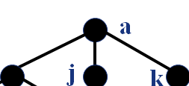
Theorem 5: There are l≤ m^h leaves in an m-ary tree of height h.
Proof: The proof uses mathematics induction on the height.
Basic case. consider m-ary trees of height 1.
These trees consist of a root with no more than m children, each of which is a leaf.
Hence there are no more than m^1 = m leaves in an m-ary tree of height 1.

Slide 54
Proof of Theorem 5
Inductive case. Now assume that the result is true for all m-ary trees of height < h.
Let T be an m-ary tree of height h.
a
b
j
k
c
e
f
l
d
g
i
g
i
h

Slide 55
Proof of Theorem 5
Let T be an m-ary tree of height h.
Leaf(a)=Leaf(b) +Leaf(j)+Leaf(k)+…..
≤ m^(h-1)+ m^(h-1)+…..
=m* m^(h-1)
a
b
j
k
c
e
f
l
d
g
i
g
i
h

Slide 56
Corollary 1: If an m-ary tree has l leaves, then its height h ≥ .
Proof:
1. We know that from Theorem 5. then
Since h is an integer, we have

Slide 57
Corollary 2: If the m-ary tree is full and balanced, then h = .
Proof:
There is at least one leaf at level h. we have

Slide 58
Homework
7
12

Slide 59
End of Section 10.1
Click to edit company slogan .
59

